Slide 1
Partial Differential Equations (PDEs) Heat Equation
Alkassab Thaer Q39HXA
Abarca Zuniga Bernold Rodrigo E4NGIC

Slide 2

Heat Equation Formula and the initial and boundary conditions
$$\frac{∂T}{∂t}=d.\frac{∂^{2}T}{{∂x}^{2}}+S\left(x,t\right)$$
$$T\left(0,t\right)=α_{0}(t)$$
$$T\left(L,t\right)=α_{L}(t)$$
$$T\left(x,0\right)=β (t)$$

Slide 3

Parameters for the heat equation
$$N = 100$$
$$w = np.zeros(N)$$
$$L = 10$$
$$h = L / (N+1)$$
$$d = 0.1$$
$$steps = 40_000$$
$$dt = 0.02$$

Slide 4

Initial and boundary conditions
$def S(x, t):$
$return np.exp⁡( −(x−L/2)∗∗2 / L/2) + 1/(t+1)$
$def alpha0( t ):$
$return 20 + 100 ∗ np.sin⁡( t / 100 )$
$def alphaL( t ):$
$return 100 + 100 ∗ np.cos⁡( t / 100 )$
$def beta( x ):$
$return 300$

Slide 5
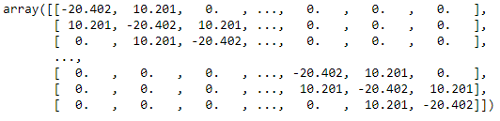
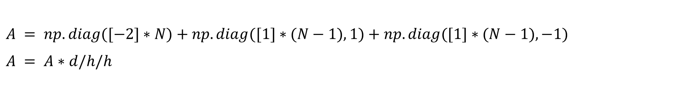
Calculating A matrix
$A = np.diag([−2]∗N)+np.diag([1]∗(N−1),1)+np.diag([1]∗(N−1),−1)$
$A = A∗d/h/h$

Slide 6
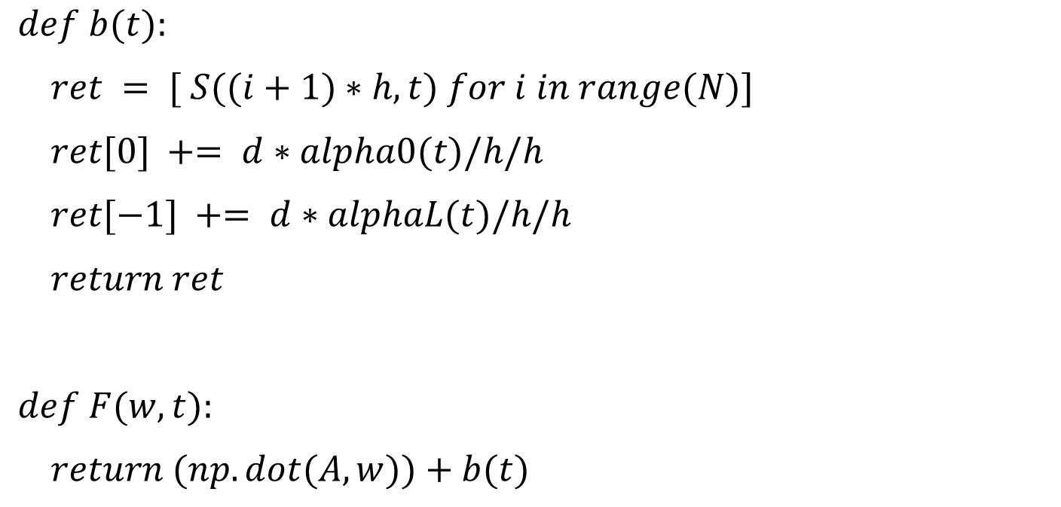
Calculating the right side of w’
$def b(t):$
$ret = [ S((i+1)∗h, t) for i in range(N)]$
$ret[0] += d∗alpha0(t)/h/h$
$ret[−1] += d∗alphaL(t)/h/h$
$return ret$
$def F(w, t):$
$return (np.dot(A,w))+b(t)$

Slide 7
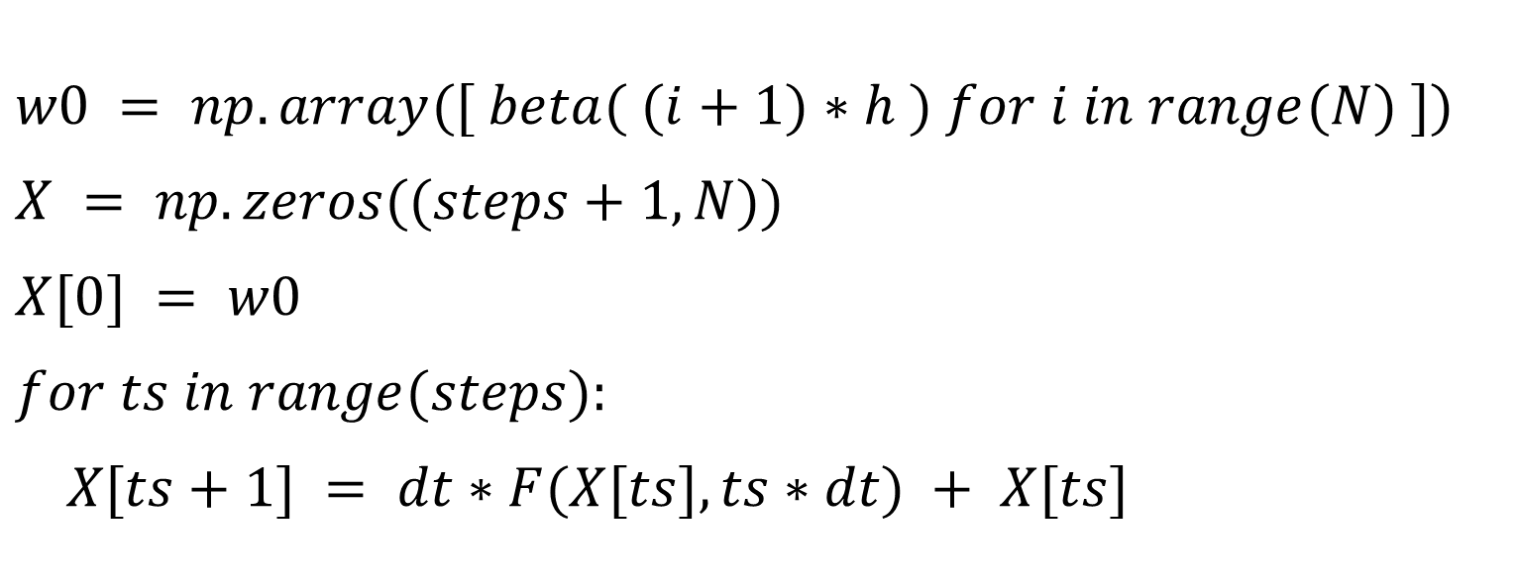
Explicit Euler
$w0 = np.array([ beta( (i+1)∗h ) for i in range(N) ])$
$X = np.zeros((steps+1,N))$
$X[0] = w0$
$for ts in range(steps):$
$X[ts+1] = dt∗F(X[ts], ts∗dt) + X[ts]$

Slide 8
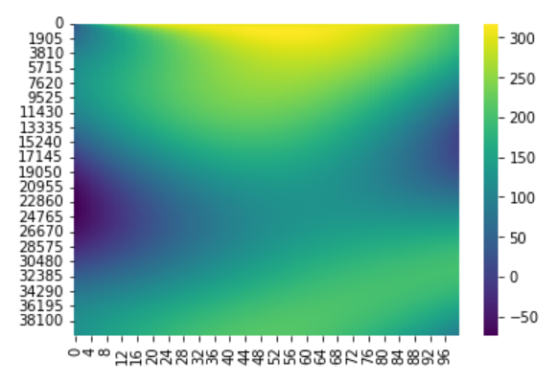
Heatmap

Slide 9

Reduce equation
$$A_{r}=U_{r}^{T}.A.U$$
$$α_{0}=U_{r}^{T}w_{0}$$
$$b_{r}=U_{r}^{T}.b$$
$$α^{′}=A_{r}.α+b_{r}$$

Slide 10
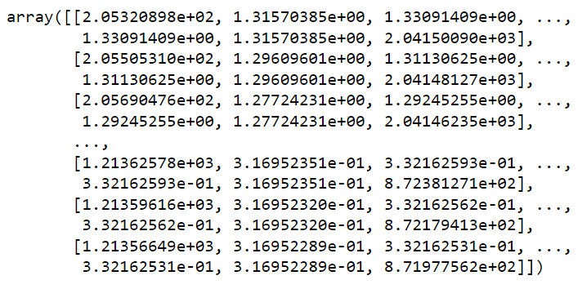
Reducing the source
$$Source_m = np.array([b(ts∗dt) for ts in range(steps+1)])$$

Slide 11
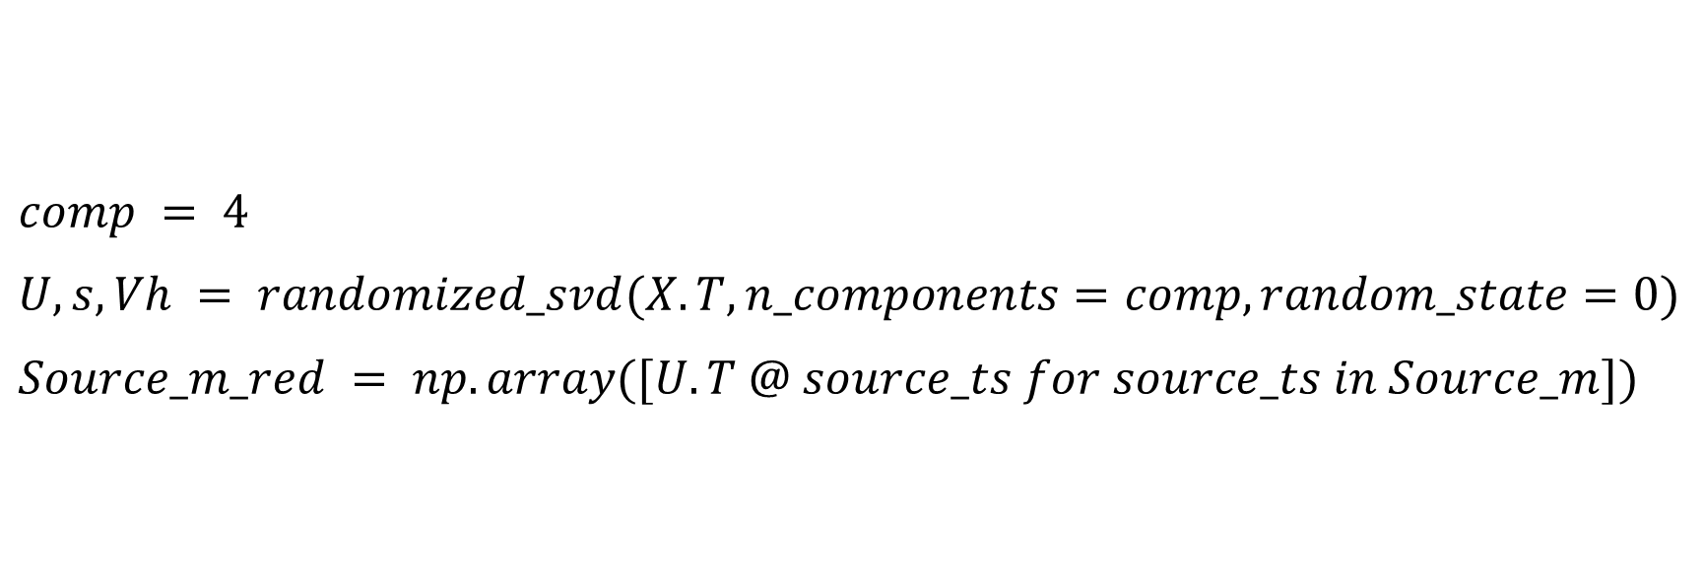
Single Value Decomposition for the heat eq
$comp = 4$
$U,s,Vh = randomized_svd(X.T,n_components=comp,random_state=0)$
$Source_m_red = np.array([U.T @ source_ts for source_ts in Source_m])$

Slide 12
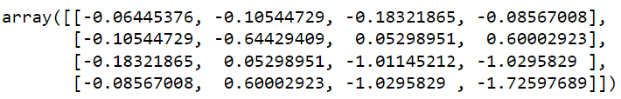
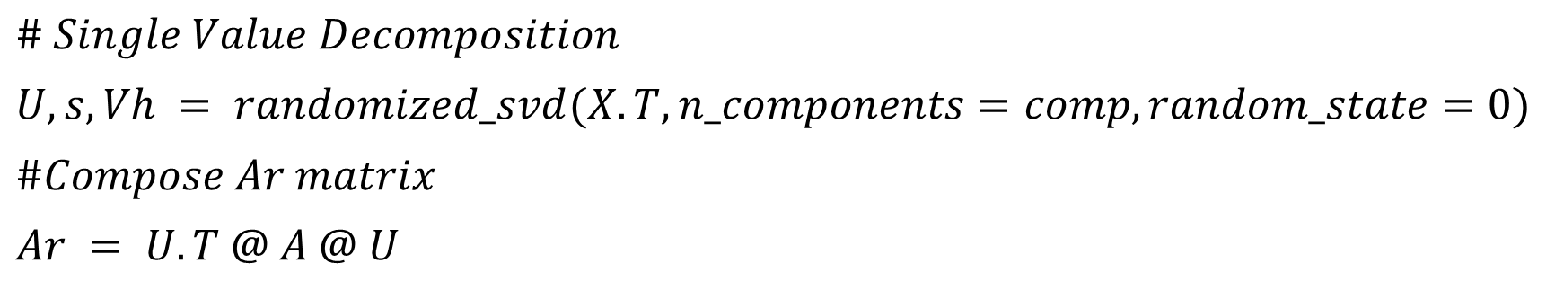
Reducing the Heat eq
$\# Single Value Decomposition$
$U,s,Vh = randomized_svd(X.T,n_components=comp,random_state=0)$
$\#Compose Ar matrix$
$Ar = U.T @ A @ U$

Slide 13

Calculating the right side of w’
$def br(t):$
$$return Source_m_red[t] \# Source_{m_{red}has}the heat source already reduced$$
$def Fr(w, t):$
$return (np.dot(Ar,w))+br(t)$

Slide 14
Explicit Euler
wr0 = U.T@w0
Xr = np.zeros((steps+1,4))
Xr[0] = wr0
for ts in range(steps):
Xr[ts+1] = dt*Fr(Xr[ts], ts) + Xr[ts]

Slide 15
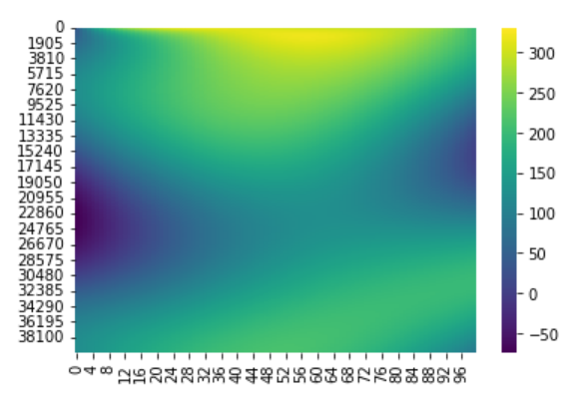
Heatmap for the redacted eq

Slide 16
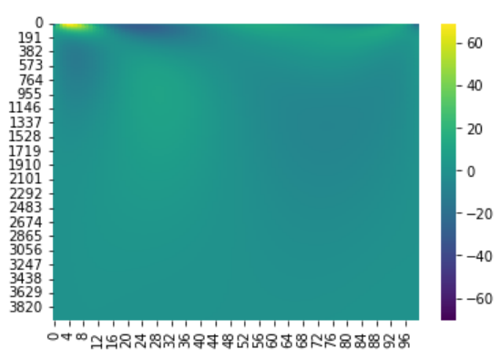
Results and conclusions
Comparing the error

Slide 17
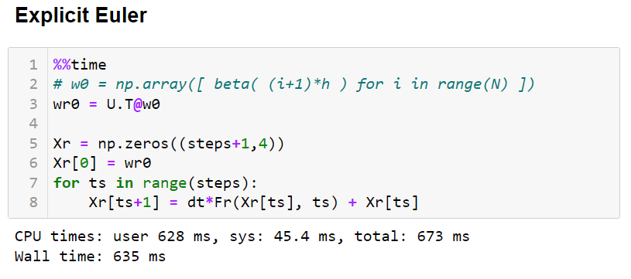
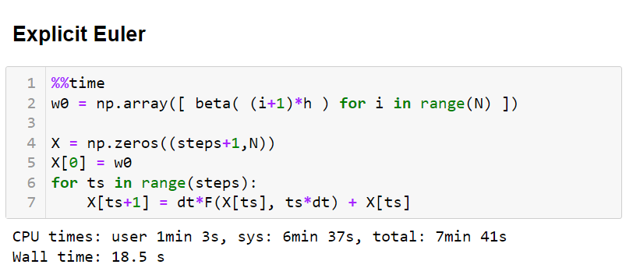
Results and conclusions
Comparing the time

Slide 18
Results and conclusions
Comparing the time

Slide 19
Thank you for your attention

